Slide 1
Course Project
Team No. 5
Ayushi Negi 01FE19BEC218
Burhan Darugar 01FE19BEC232

Slide 2
Agenda
Problem statement
Architecture
Simulation
Synthesis

Slide 3
Problem Statement
Parallel Multiplier – Accumulator Based on Radix – 2 Modified Booth Algorithm.

Slide 4
Repeated Addition
Repeated addition is adding equal groups together. It is also known as multiplication. If the same number is repeated.
The number to be added is the multiplicand, the number of times that it is added is the multiplier, and the result is the product.
1010 x1010 = 1010 +1010 +1010 + .......+1010 [1010] times
2^N -1 Cycles for N bit input
Modified Booth’s Algorithm

Slide 5
Booth Multiplication
Booth's multiplication algorithm is a multiplication algorithm that multiplies two signed binary numbers in two's complement notation.
Modified Booth’s Algorithm

Slide 6
Working of the Booth Algorithm
→ Set the Multiplicand and Multiplier binary bits as M and Q, respectively.
→ Initially, we set the AC and Q_{n + 1} registers value to 0.
→ SC represents the number of Multiplier bits (Q), and it is a sequence counter that is continuously decremented till equal to the number of bits (n) or reached to 0.
→ A Qn represents the last bit of the Q, and the Q_{n+1} shows the incremented bit of Qn by 1.
→ On each cycle of the booth algorithm, Q_{n} and Q_{n + 1} bits will be checked on the following parameters as follows:
→ When two bits Q_{n} and Q_{n + 1} are 00 or 11, we simply perform the arithmetic shift right operation (ASR) to the partial product AC. And the bits of Qn and Q_{n + 1} is incremented by 1 bit.
→ If the bits of Q_{n} and Q_{n + 1} is shows to 01, the multiplicand bits (M) will be added to the AC (Accumulator register). After that, we perform the right shift operation to the AC and QR bits by 1.
→ If the bits of Q_{n} and Q_{n + 1} is shows to 10, the multiplicand bits (M) will be subtracted from the AC (Accumulator register). After that, we perform the right shift operation to the AC and QR bits by 1.
→ The operation continuously works till we reached n - 1 bit in the booth algorithm.
→ Results of the Multiplication binary bits will be stored in the AC and QR registers.

Slide 7
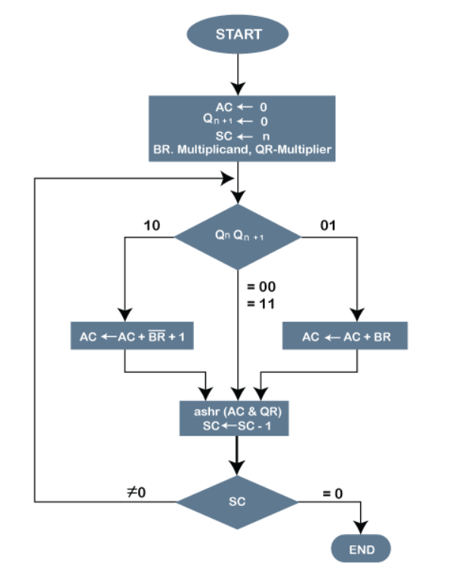
N clock cycles for a N bit number
1010
X 1010
0000
1010x
0000xx
1010xxx
01010100
Multiplicand
Multiplier
Partial 1
Partial 2
Partial 3
Partial 4
Product
DRAWBACKS
→ Inefficiency of the circuit when isolated 1's are encountered and difficulty in designing parallel multipliers as number of shift-and-add operations vary.
→It is time consuming.
→If digital gates are more, chip area would be large.

Slide 8
Modified Booth Algorithm
In order to achieve high-speed, multiplication algorithms using parallel counters, such as the modified Booth algorithm has been proposed, and some multipliers based on the algorithms have been implemented for practical use.
This type of multiplier operates much faster than an array multiplier for longer operands because its computation time is proportional to the logarithm of the word length of operands.

Slide 9
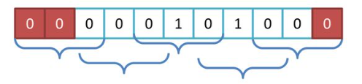
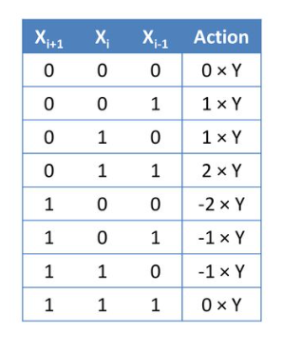
STEP 1: Booth Encoding
Here Rather than Single bit we are using Three bits at a time
STEP 2: Partial Product Summation & Accumulation
Partial product is generated on the basis of the bit
Here we can see in the booth encoding for N bit no N/2 Partial products are generated
STEP 3: Final Addition
In our module in a single clock cycle all the Accumulated partial products are added using CLA adder

Slide 10
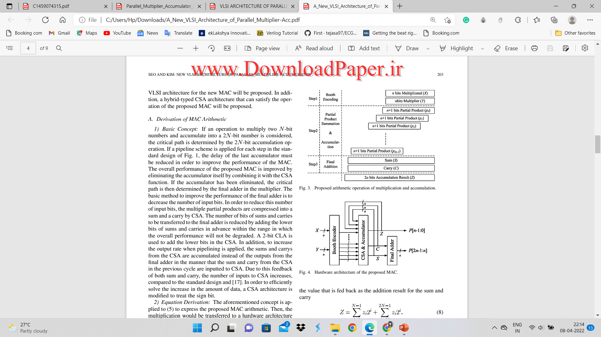
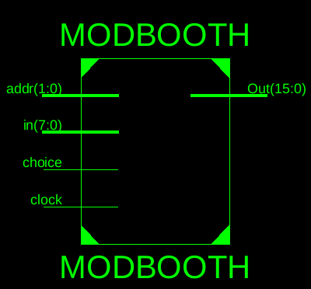
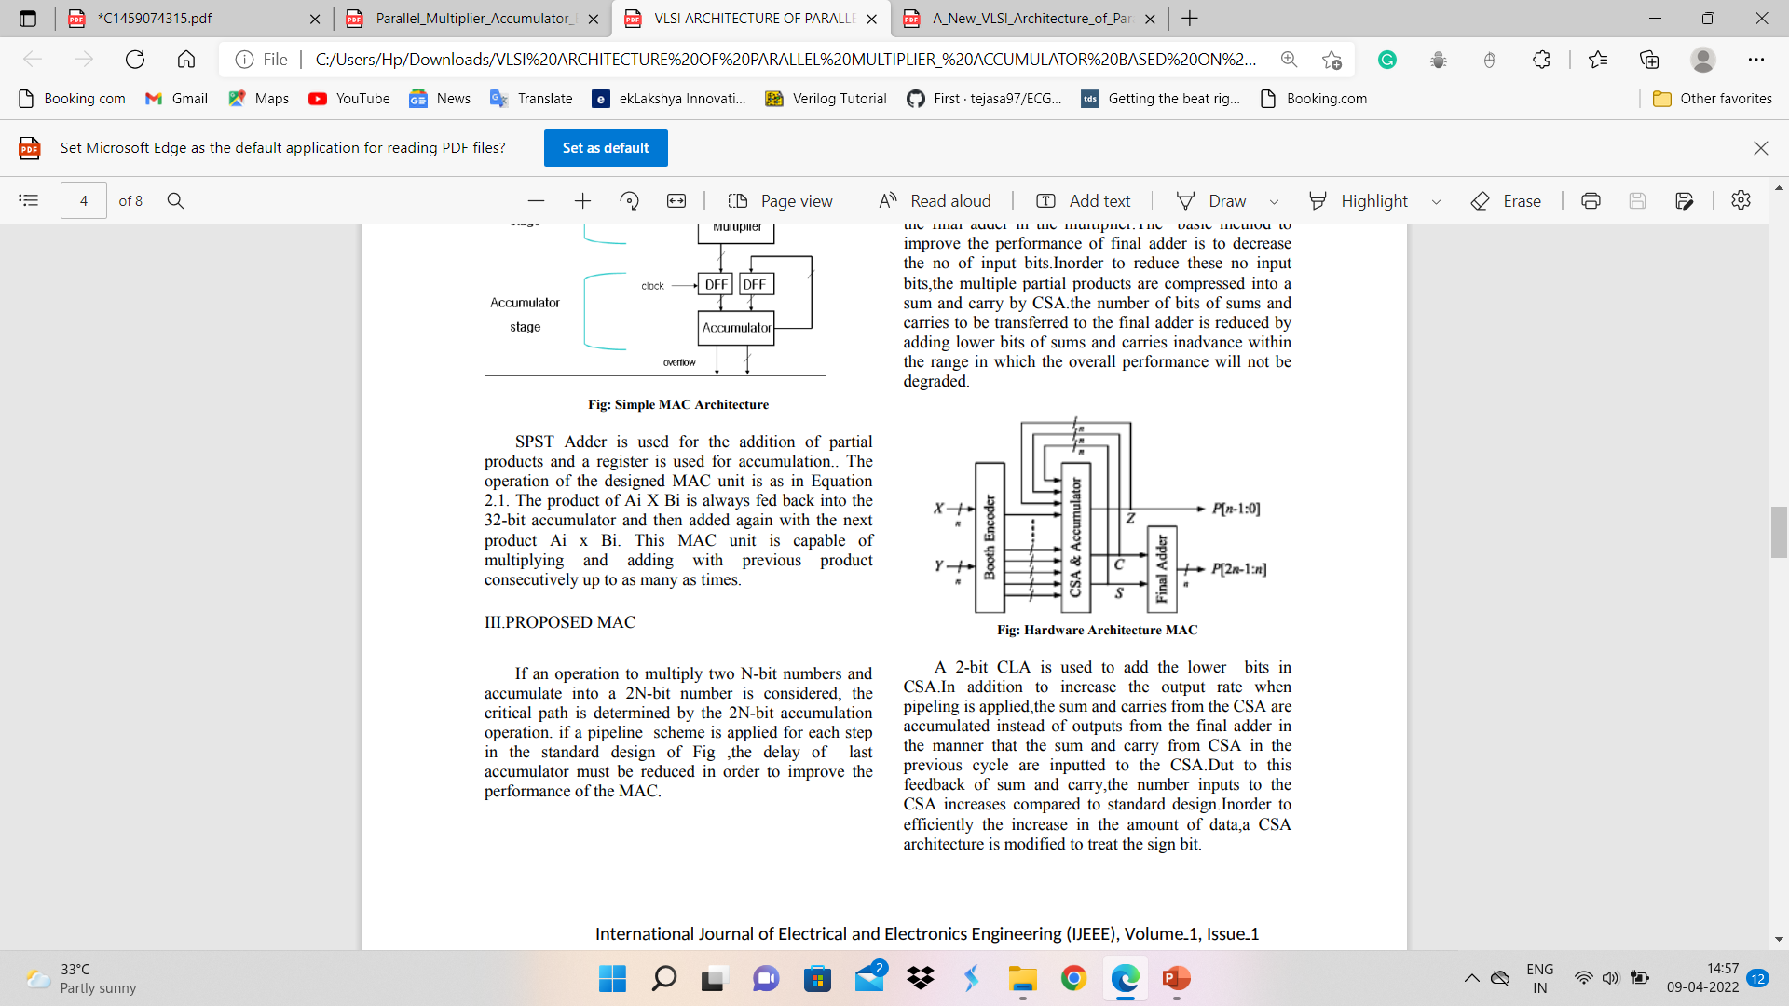
Architecture
Process of Modified Booth Encoding
RTL

Slide 11
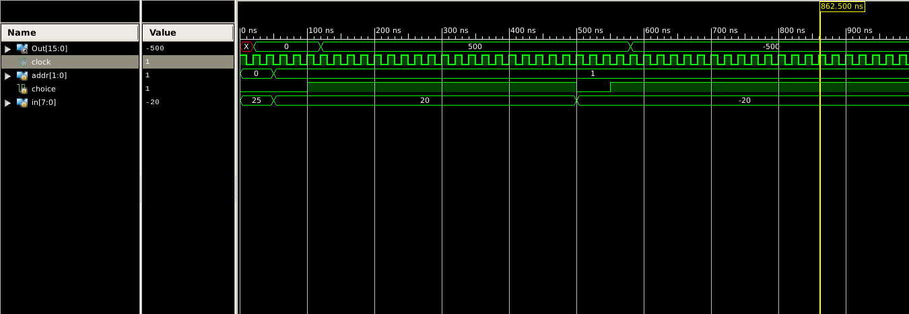

Result
Choice = 0
→ R0 = Store @(Multiplicand) R1 = Store@(Multiplier)
Choice = 1
→Product = [ R0 * R1 ]
REPEATED ADDITION BOOTH MODIFIED BOOTH

Slide 12
Thank you

